Slide 1

Faculty of Engineering and Technology
Parul Institute of Technology
Department: Computer Science & Engineering
Course: B.Tech – CSE
Subject: Computational Thinking for Structured Design-1
Subject Code: 303105104

Slide 2
Unit 6
Transaction

Slide 3
:Transaction:
Transaction is a collection of operations that form a single logical unit of work.
It is a logical unit of program execution that contains one or more SQL statements and accesses and possibly updates various data items.

Slide 4
:States of Transaction:
1. Active: Transaction stays in this state while it is executing.
2. Aborted: Transaction may not always complete its execution successfully.
3. Partially Committed: Transaction stays in this state before the final statement has been executed.
4. Committed: Transaction completes its execution successfully.
5. Failed: Transaction stays in this state after the discovery that normal execution can no longer proceed.

Slide 5
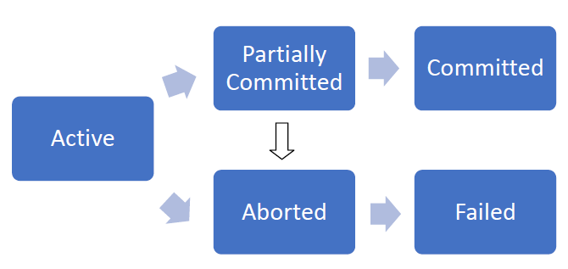
:States of Transaction:

Slide 6
:ACID Properties:
A transaction in a database system must maintain Atomicity, Consistency, Isolation, and Durability − commonly known as ACID properties − in order to ensure accuracy, completeness, and data integrity.

Slide 7
:Atomicity:
This property states that either all operations of the transaction are reflected properly in the database, or none are.
Consider a transaction to transfer Rs. 50 from account A to account B. In this transaction, if Rs. 50 is deducted from account A then it must be added to account B.

Slide 8
:Consistency:
The database must remain in a consistent state after any transaction.
If the database was in a consistent state before the execution of a transaction, it must remain consistent after the execution of the transaction as well.
In our example, total of A and B must remain same before and after the execution of transaction.

Slide 9
:Isolation:
Even though multiple transactions may execute concurrently, the system guarantees that once your transaction start from step one its result should not be accessed by any other transaction until last step is completed.
Each transaction is unaware of other transactions executing concurrently in the system.

Slide 10
:Durability:
After a transaction completes successfully, the changes it has made to the database persist, even if there are system failures.

Slide 11
:Schedule:
Schedule is a sequence of instructions that specify the chronological order in which instructions of concurrent transactions are executed.
It must consist of all instructions of those transactions.
It must preserve the order in which the instructions appear in each individual transaction.

Slide 12
:Examples of Schedule:
Example 1:
Let T1 transfer $50 from A to B, and T2 transfer 10% of the balance from A to B.
A serial schedule in which T1 is followed by T2.

Slide 13
:Examples of Schedule:
Example 2:
Let T1 transfer $50 from A to B, and T2 transfer 10% of the balance from A to B.
A serial schedule in which T2 is followed by T1.

Slide 14
:Examples of Schedule:
Example 3:
The following schedule is not a serial schedule, but it is equivalent to Example 1.

Slide 15
:Examples of Schedule:
Example 4:
The following schedule does not preserve the value of A+B.

Slide 16
:Types of Schedule:

Slide 17
:Types of Schedule:
Recoverable schedule:
Transactions must be committed in order in this schedule. Dirty Read problem and Lost Update problem may occur.
Cascadeless schedule:
Dirty Read not allowed, means reading the data written by an uncommitted transaction is not allowed in this schedule. Lost Update problem may occur.
Strict schedule:
Neither Dirty read nor Lost Update problem allowed in this schedule, means reading or writing the data written by an uncommitted transaction is not allowed.

Slide 18
:Dirty Read Problem:
Reading the data written by an uncommitted transaction is called as Dirty Read.
There is always a chance that the uncommitted transaction might roll back later. Thus, uncommitted transaction might make other transactions read a value that does not even exist. This leads to inconsistency of the database.

Slide 19
:Dirty Read Problem:

Slide 20
:Dirty Read Problem:
There is no Dirty Read problem if a transaction is reading from another committed transaction. So, no rollback required.

Slide 21
:Lost Update Problem:
In the lost update problem, an update done to a data item by a transaction is lost as it is overwritten by the update done by another transaction.
Transaction 1 changes the value of X but it gets overwritten by the update done by transaction 2 on X. Therefore, the update done by transaction 1 is lost.

Slide 22
:Lost Update Problem:

Slide 23
:Cascading Rollback Problem:
If in a schedule, failure of one transaction causes several other dependent transactions to rollback or abort, then such a schedule is called as a Cascading Rollback or Cascading Abort or Cascading Schedule. It simply leads to the wastage of CPU time. These Cascading rollbacks occur because of Dirty Read problems.
For example, transaction T1 writes uncommitted x that is read by Transaction T2. Transaction T2 writes uncommitted x that is read by Transaction T3. Suppose at this point T1 fails. T1 must be rolled back, since T2 is dependent on T1, T2 must be rolled back, and since T3 is dependent on T2, T3 must be rolled back.
Because of T1 rollback, all T2, T3, and T4 should also be rollback (Cascading dirty read problem). This phenomenon, in which a single transaction failure leads to a series of transaction rollbacks, is called Cascading rollback.

Slide 24
:Cascading Rollback Problem:

Slide 25
:Cascadeless Schedule:
This schedule avoids all possible Dirty Read Problem.
In Cascadeless Schedule, if a transaction is going to perform read operation on a value, it has to wait until the transaction who is performing write on that value commits. That means there must not be Dirty Read. Because Dirty Read Problem can cause Cascading Rollback, which is inefficient.
Cascadeless Schedule avoids cascading aborts/rollbacks. Schedules in which transactions read values only after all transactions whose changes they are going to read commit are called cascadeless schedules. A strategy to prevent cascading aborts is to disallow a transaction from reading uncommitted changes from another transaction in the same schedule.
In other words, if some transaction Tj wants to read value updated or written by some other transaction Ti, then the commit of Tj must read it after the commit of Ti.

Slide 26
:Cascadeless Schedule:

Slide 27
:Serializability:
It is assumed that when each transaction preserves database consistency, serial execution of a set of transactions also preserves database consistency.
There are two ways to check serializability: Conflict serializability and View serializability.
Keep in mind:
When a schedule is conflict serializable or view serializable, it will be serializable. It means there will surely be a similar or equivalent schedule. When a schedule is serializable, it will surely be a consistent one.

Slide 28
Flowchart for finding if the transactions are consistent or not:

Slide 29
:Conflict Serializability:
Instructions li and lj of transactions Ti and Tj respectively, conflict if and only if there exists some item Q accessed by both li and lj, and at least one of these instructions wrote Q.
1. li = read(Q), lj = read(Q) => Don’t conflict.
2. li = read(Q), lj = write(Q) => Conflict.
3. li = write(Q), lj = read(Q) => Conflict.
4. li = write(Q), lj = write(Q) => Conflict.
If a schedule S can be transformed into a schedule S´ by a series of swaps of non-conflicting instructions, we say that S and S´ are conflict equivalent. We say that a schedule S is conflict serializable if it is conflict equivalent to a serial schedule.

Slide 30
:View Serializability:
It is used to find out if a schedule is serializable or not, when a schedule is not conflict serializable.

Slide 31
:Examples:

Slide 36
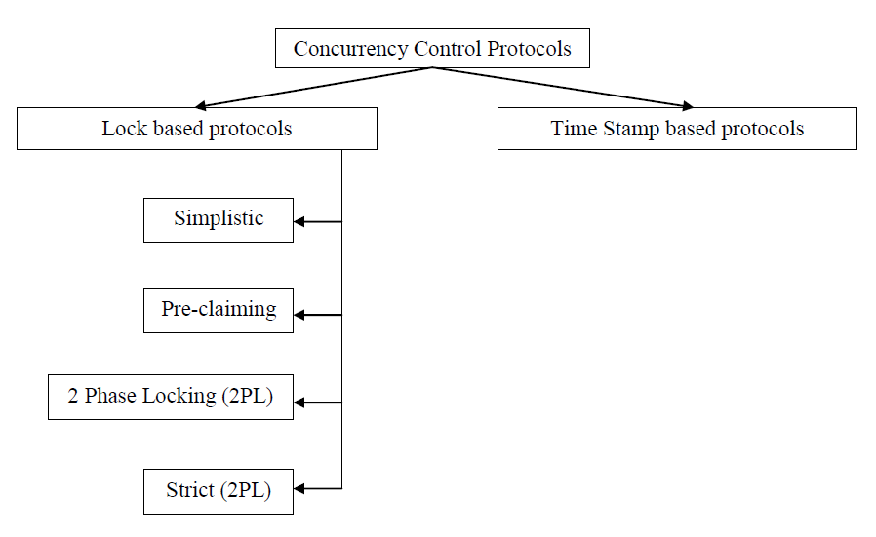
:Concurrency Control Protocols:
When multiple transactions are executed concurrently, it is important to maintain concurrency of all the transactions. Protocols are used to maintain ACID properties of all the transaction.

Slide 37
:Timestamp based Protocols:
Timestamp is a unique identifier created by the DBMS to identify a transaction. They are usually assigned in the order in which they are submitted to the system. The timestamp of transaction Ti is denoted as TS(Ti).
Read time-stamp of data-item X is denoted by R-timestamp(X).
Write time-stamp of data-item X is denoted by W-timestamp(X).

Slide 38
:Working of Timestamp based Protocols:
• If a transaction Ti issues a read(X) operation…
– If TS(Ti) < W-timestamp(X)
• Operation rejected.
– If TS(Ti) >= W-timestamp(X)
• Operation executed.
– All data-item timestamps updated.
• If a transaction Ti issues a write(X) operation…
– If TS(Ti) < R-timestamp(X)
• Operation rejected.
– If TS(Ti) < W-timestamp(X)
• Operation rejected and Ti rolled back.
– Otherwise, operation executed.

Slide 39
:Locks:
Locks are of following types:-
(i) Binary Locks: - A lock on data items can be in two states only; it will be either locked or unlocked.
(ii) Shared: - It is also known as a Read-only lock. In a shared lock, the data item can only read by the transaction. It can be shared between the transactions because when the transaction holds a lock, then it can't update the data on the data item.
(iii) Exclusive: - In the exclusive lock, the data item can be both reads as well as written by the transaction. This lock is exclusive, and in this lock, multiple transactions do not modify the same data simultaneously.

Slide 40
:Locks:
Any number of transactions can hold shared locks on an item, but if any transaction holds an exclusive lock on the item no other transaction may hold any lock on the item.
 | Shared | Exclusive
Shared | Possible | Not Possible
Exclusive | Not Possible | Not Possible

Slide 41
:Simplistic Lock Protocol:
Lock must be obtained before every “write” operation and after completion of “write” operation transaction must release lock. Therefore any read operation is not allowed until write operation is executed successfully. So Dirty Read problem will not be occurred.

Slide 42
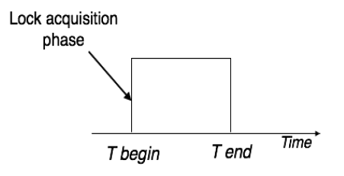
:Pre-claiming Lock Protocol:
Pre-claiming Lock Protocols evaluate the transaction to list all the data items on which they need locks. Before initiating an execution of the transaction, it requests DBMS for all the lock on all those data items.
If all the locks are granted then this protocol allows the transaction to begin. When the transaction is completed then it releases all the lock.
If all the locks are not granted then this protocol allows the transaction to rolls back and waits until all the locks are granted.

Slide 43
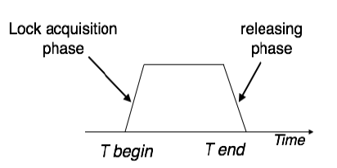
:Two Phase Locking (2PL) Protocol:
The two-phase locking protocol divides the execution phase of the transaction into three parts.
In the first part, when the execution of the transaction starts, it seeks permission for the lock it requires.
In the second part, the transaction acquires all the locks. The third phase is started as soon as the transaction releases its first lock.
In the third part, the transaction cannot demand any new locks. It only releases the acquired locks.
The process of acquiring and releasing lock is done in Growing and Shrinking Phases respectively. In Growing Phase, Locks will only get acquired. In Shrinking Phase, Locks will only get released.

Slide 44
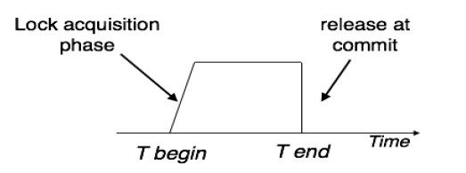
:Strict 2PL Protocol:
In the first phase, after acquiring all the locks, the transaction continues to execute normally.
The only difference between 2PL and strict 2PL is that Strict-2PL does not release a lock after using it. Strict-2PL waits until the whole transaction to commit, and then it releases all the locks at a time.
Strict-2PL protocol does not have shrinking phase of lock release.

